Slide 1




Zomato
Restaurants
Analysis
A Data-Driven Exploration using Excel, Power BI, Tableau, and MySQL
BY : GROUP 3

Slide 2


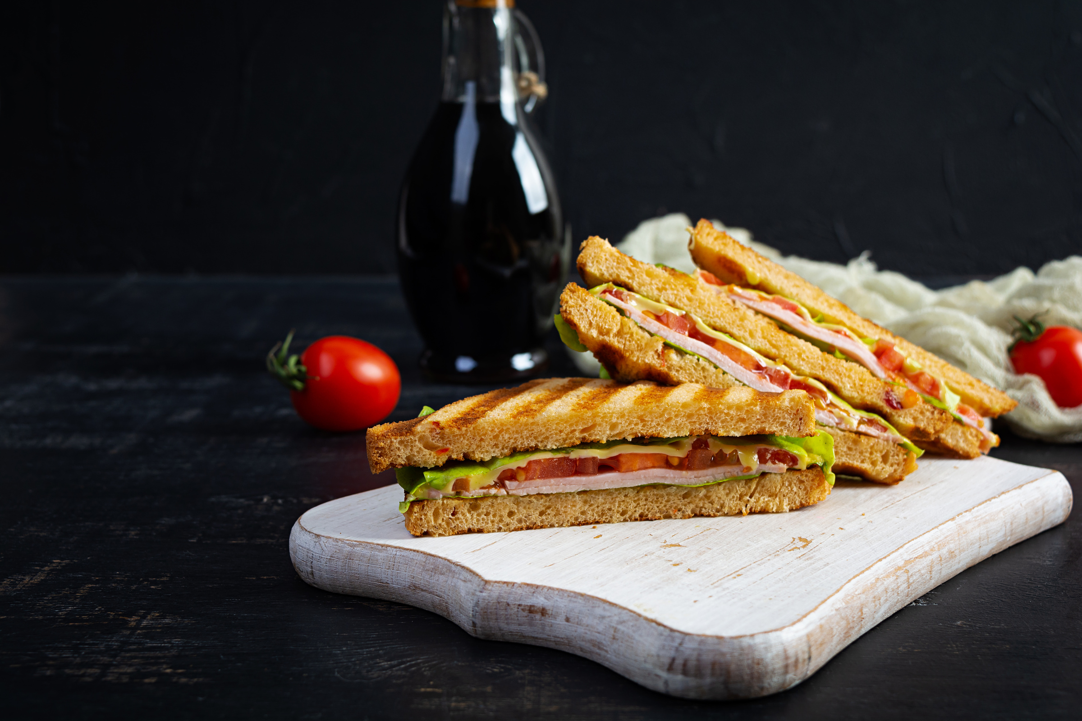


Zomato
Project Overview :
Objective: Analyze restaurant data to uncover insights on cuisines, pricing, ratings, and customer preferences.
Tools Used: Excel, Power BI, Tableau, MySQL.
Source: Zomato dataset with 9,500+ restaurants.
Key Attributes:
Restaurant name & location
Cuisine types
Average cost for two
Customer votes & ratings
Delivery & booking options
Year and month of opening
BY : NAYAN KUMAR

Slide 3

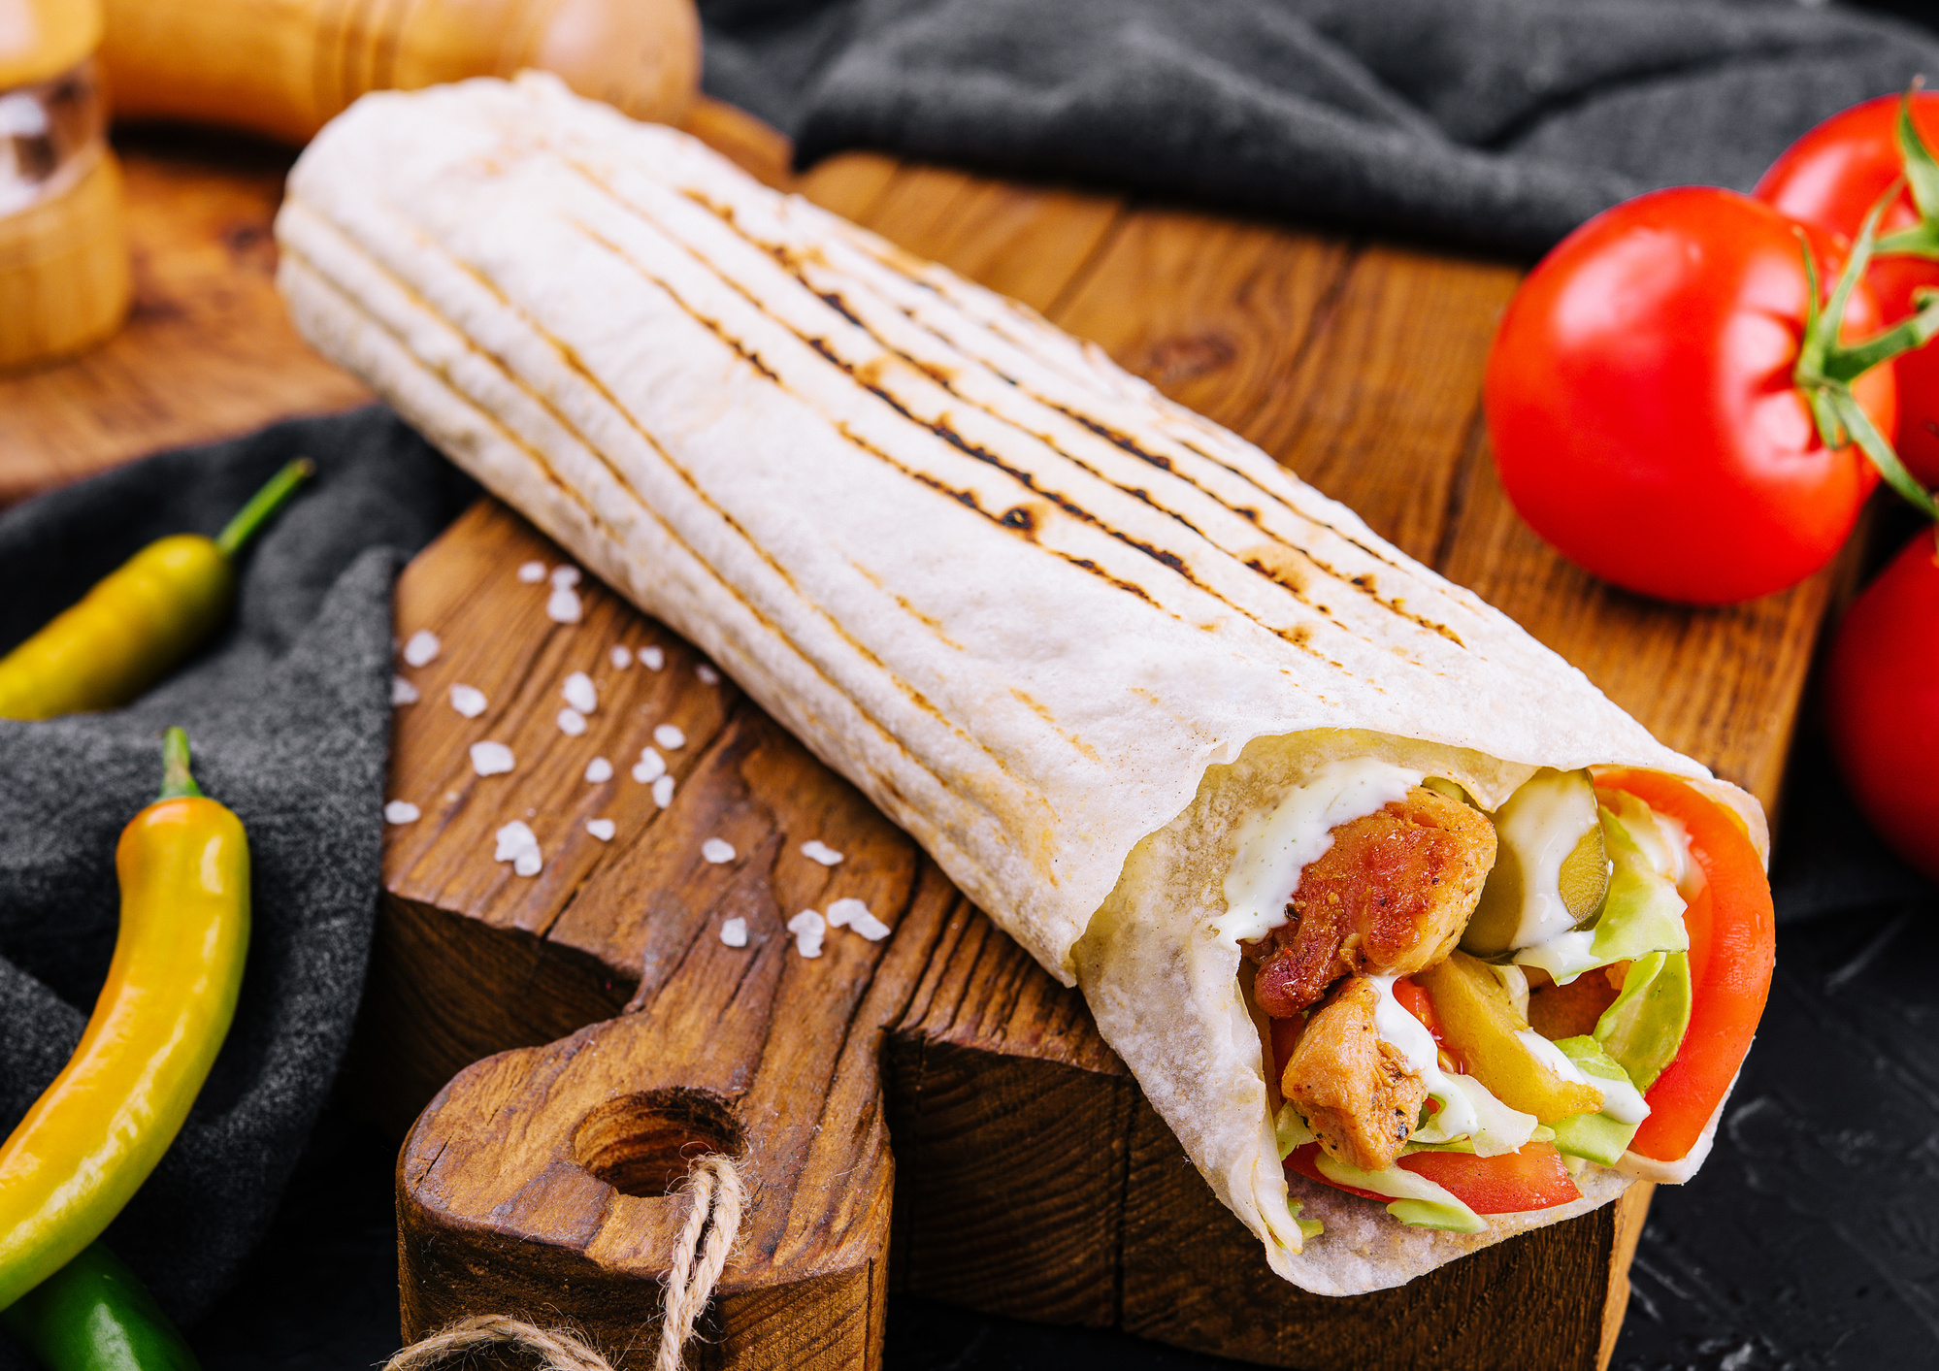

Importance of the Analysis
For Consumers: Better dining choices & awareness of trends
For Restaurants: Insights on pricing, cuisines, and customer needs
For Delivery Platforms: Helps target the right markets and cuisines
For Business Strategy: Data-driven decisions in the food industry

Slide 4

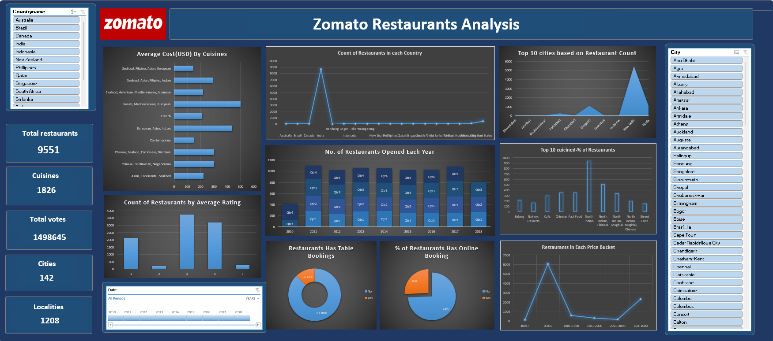
Excel Dashboard
BY : PURVA DHOTE

Slide 5

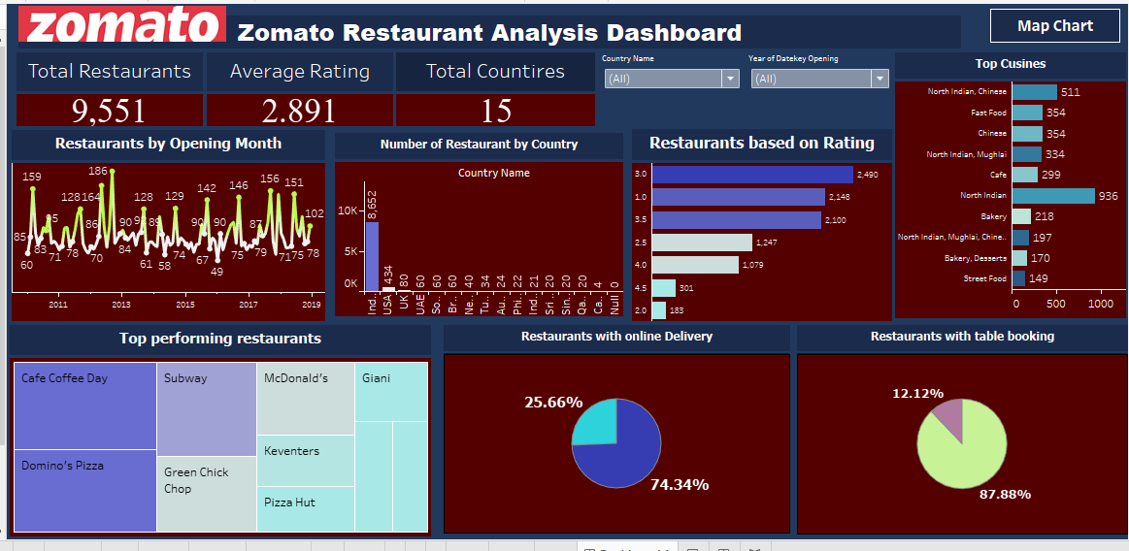
Tableau Dashboard
BY : RUSHIKESH PRAMOD POCHHI

Slide 6
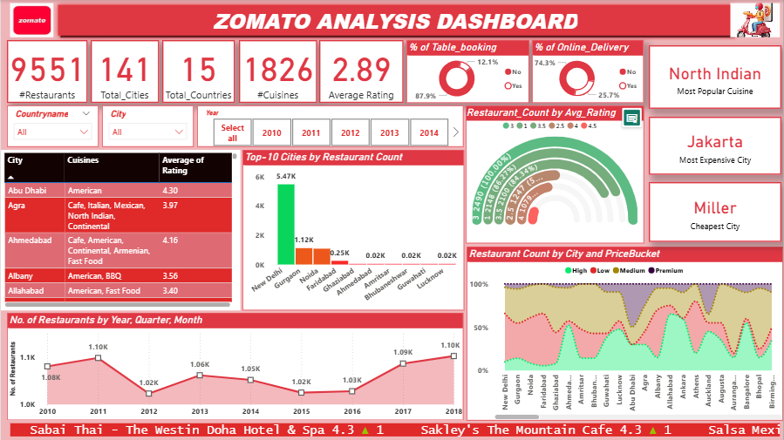
Power BI Dashboard
BY : SHIVANJLI

Slide 7



MySQL Analysis & Insights
Data Loading & Preparation in SQL
Raw Excel file → imported into MySQL.
Cleaning, handling nulls, standardizing columns.
Key SQL Queries & Insights
Calendar table
Currency conversion
Restaurant counts (City/Country)
Openings by Year/Quarter/Month
Business Insights from SQL
Ratings distribution
Price buckets (Low/Medium/High)
% with Table Booking (~12%)
% with Online Delivery (~74%)
BY : SABA ATTAR

Slide 8
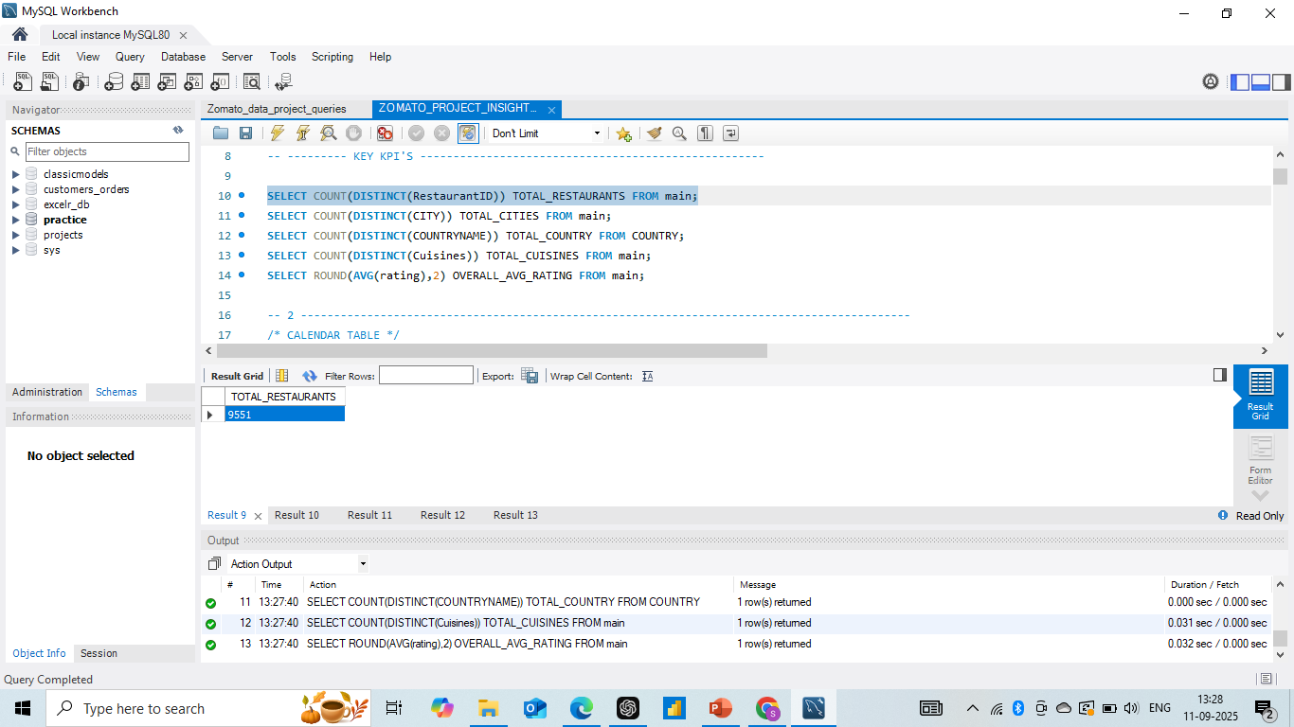
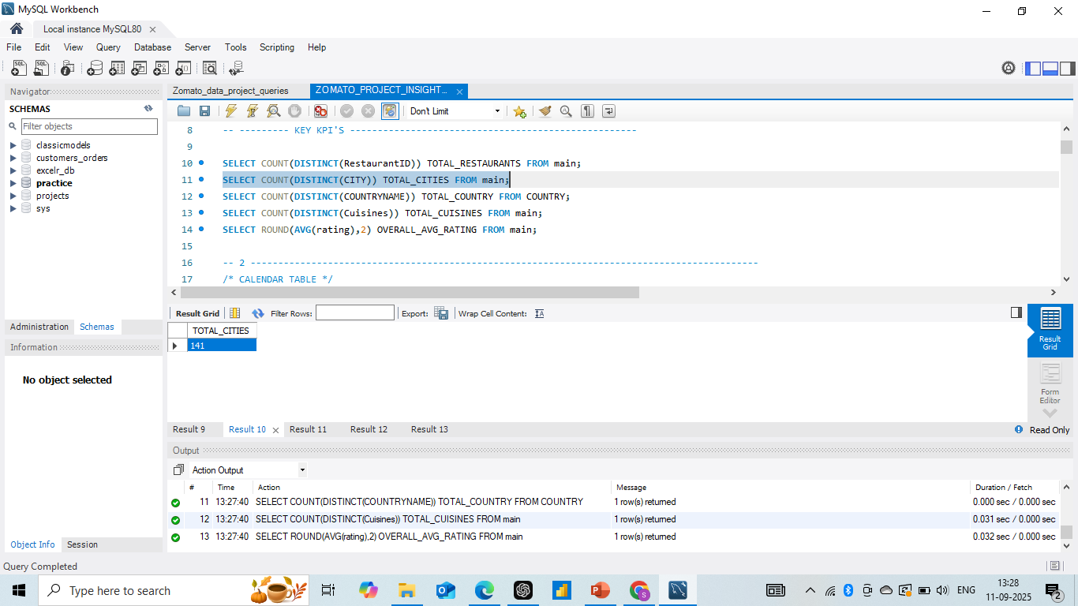
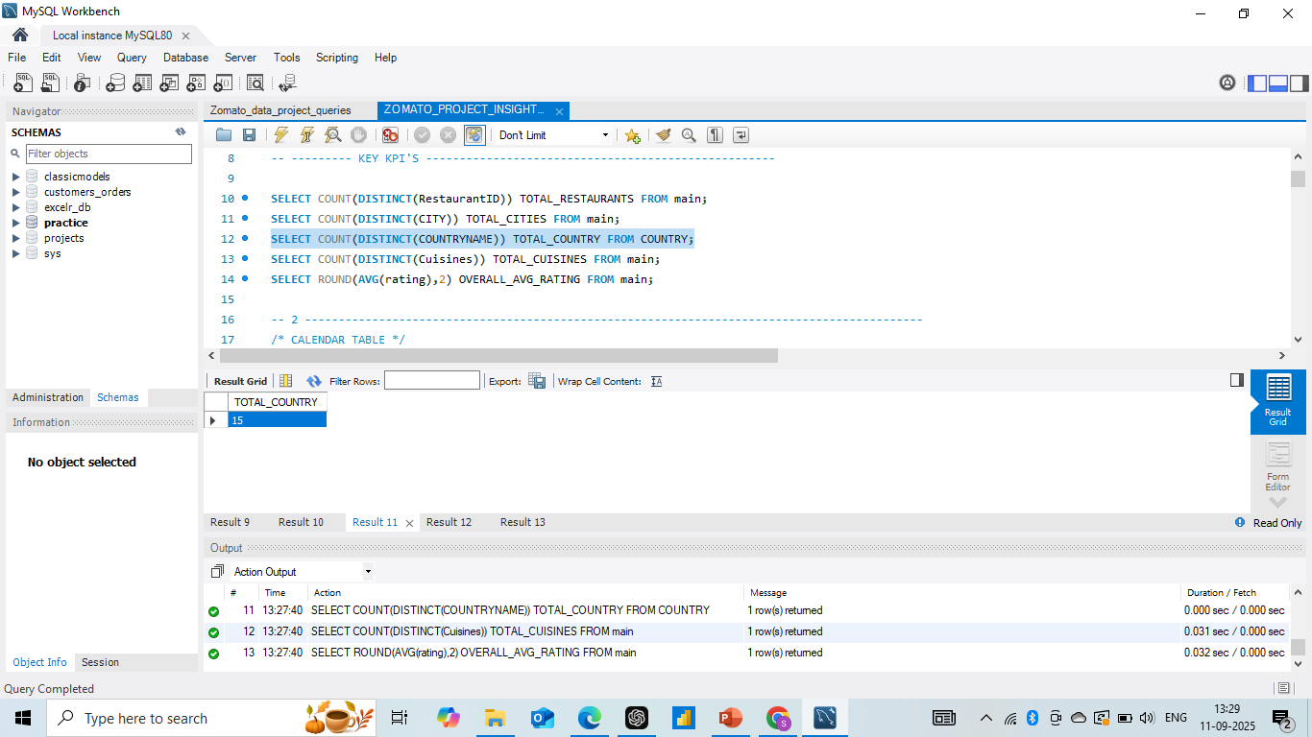
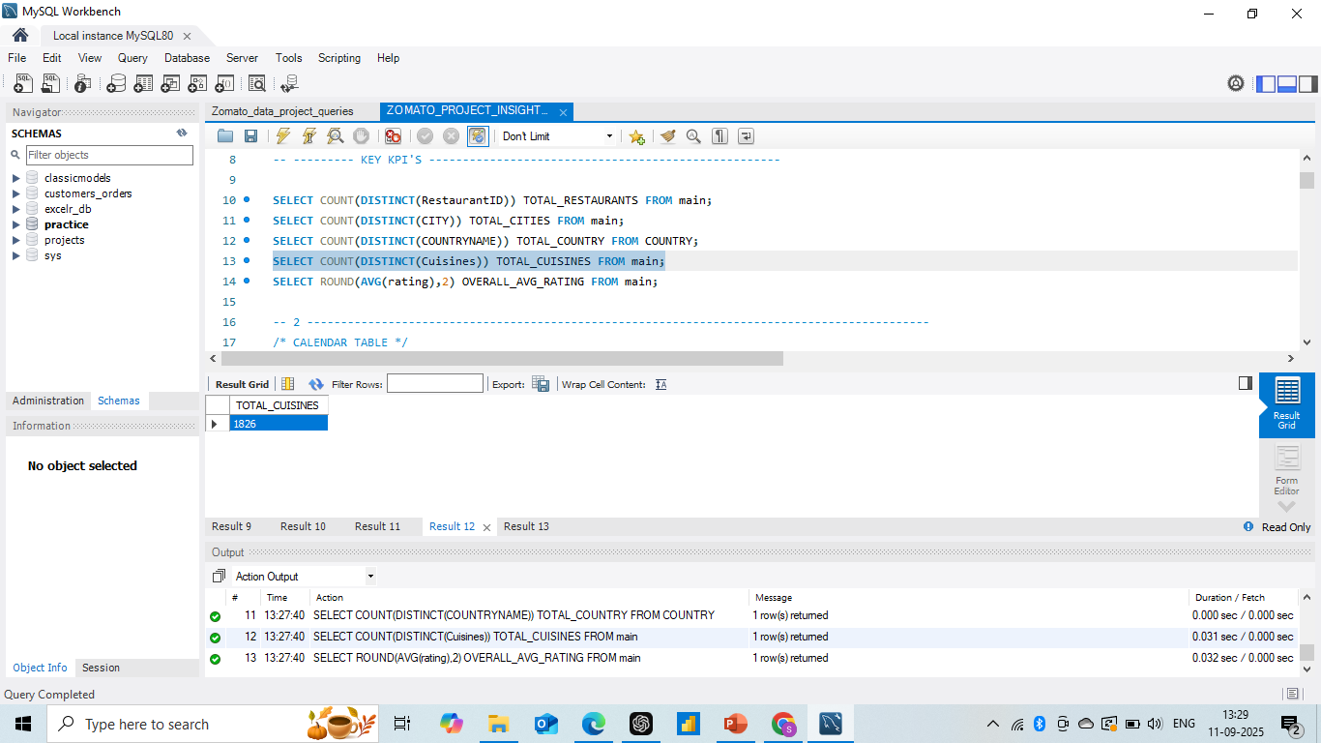
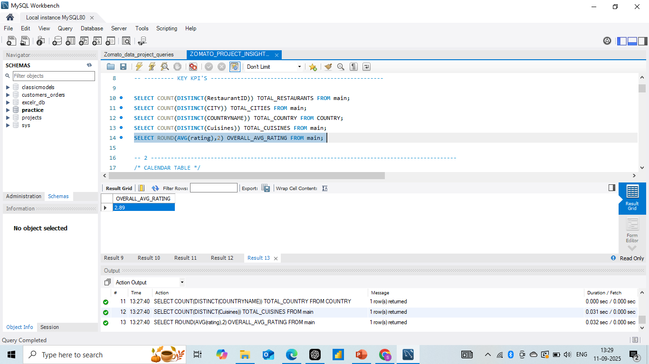

KEY KPI’ S
ZOMATO
TOTAL_RESTAURANTS9551
TOTAL_CITIES
141
TOTAL_COUNTRIES
15
TOTAL_CUISINES
1826
AVG_RATING
2.89

Slide 9

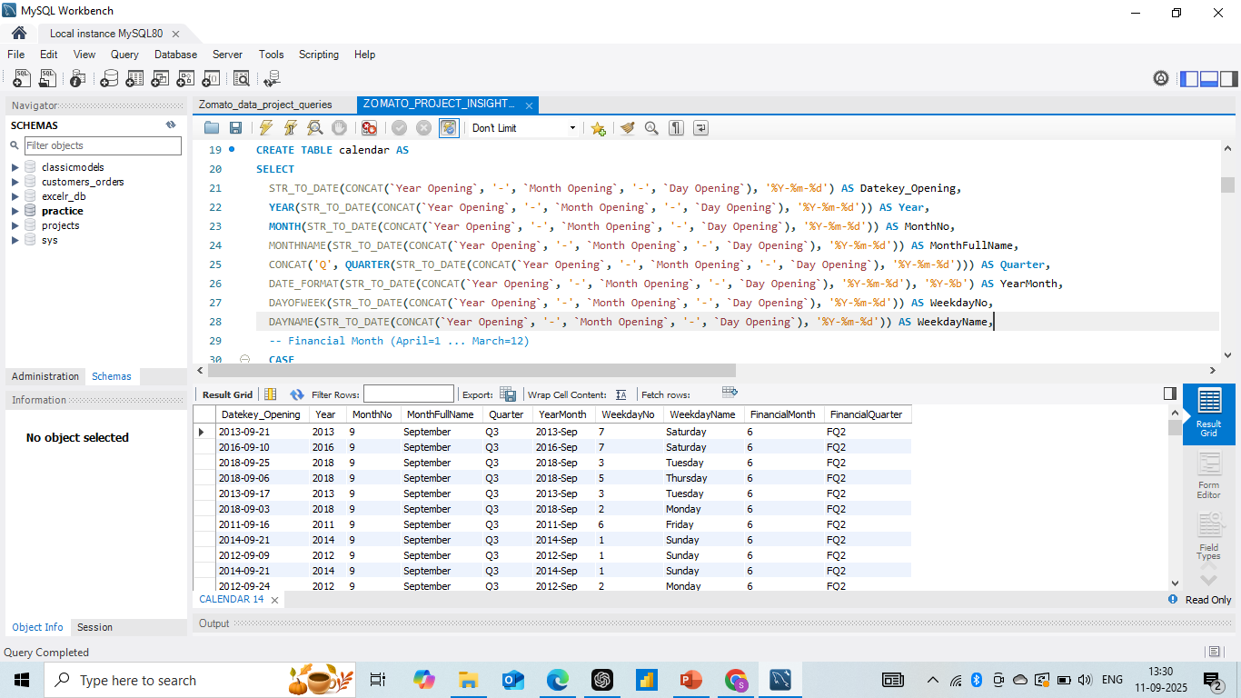
Calendar Table

Slide 10

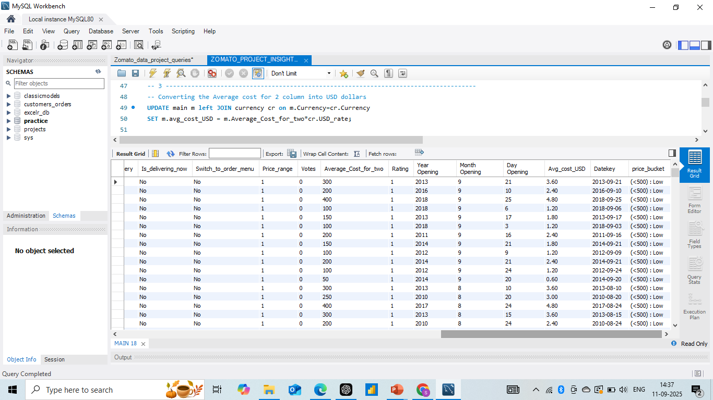
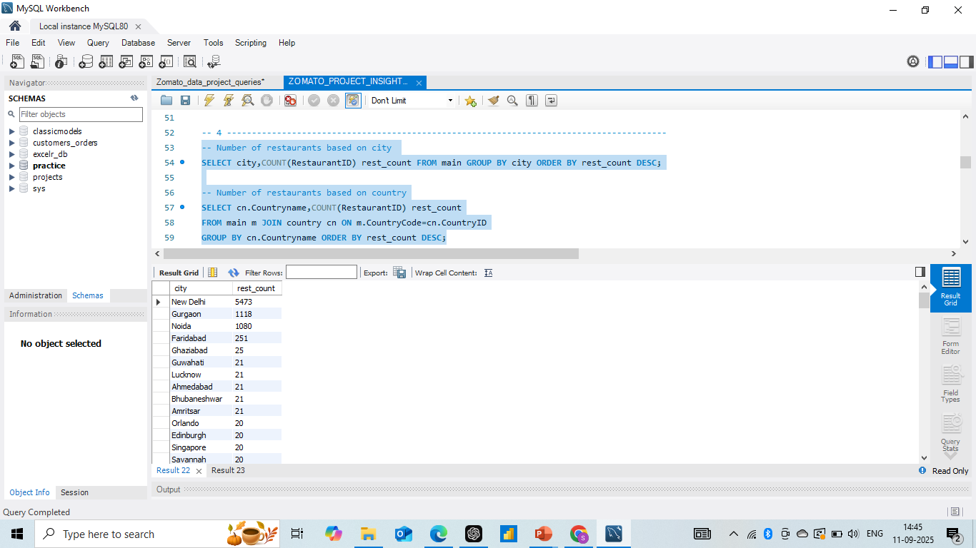
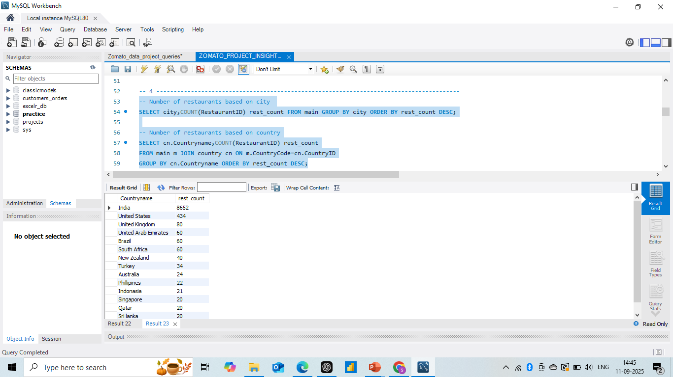

Currency Conversion
Restaurants by City & Country

Slide 11

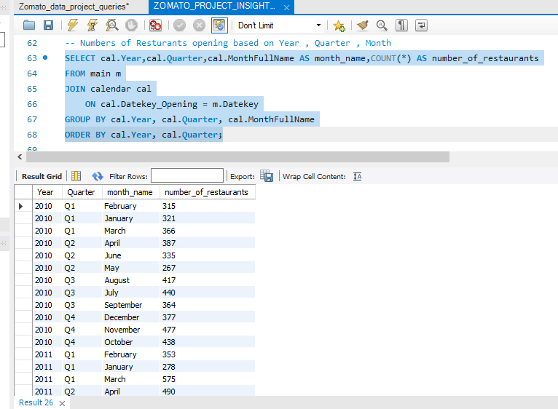

Restaurant Openings

Slide 12
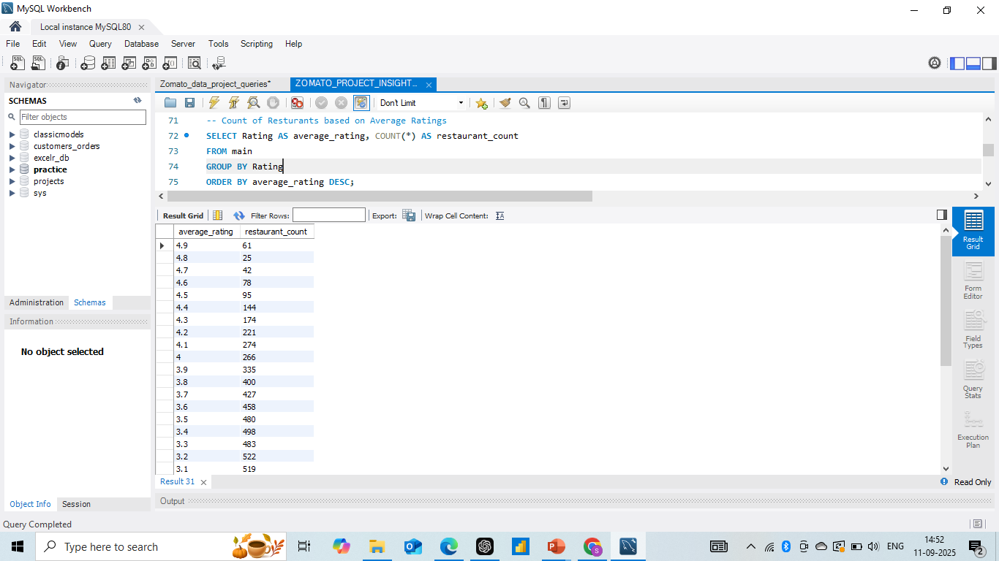
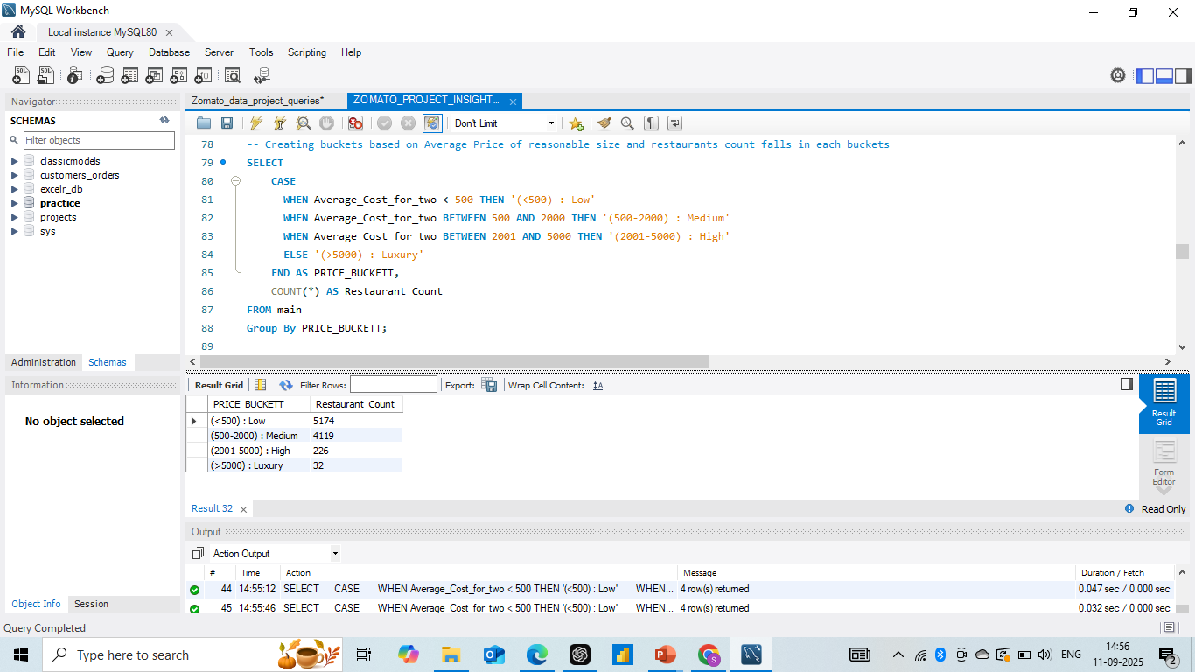
Restaurants by Avg_rating
Price Buckets
BY : VRUSHALI AWARI

Slide 13
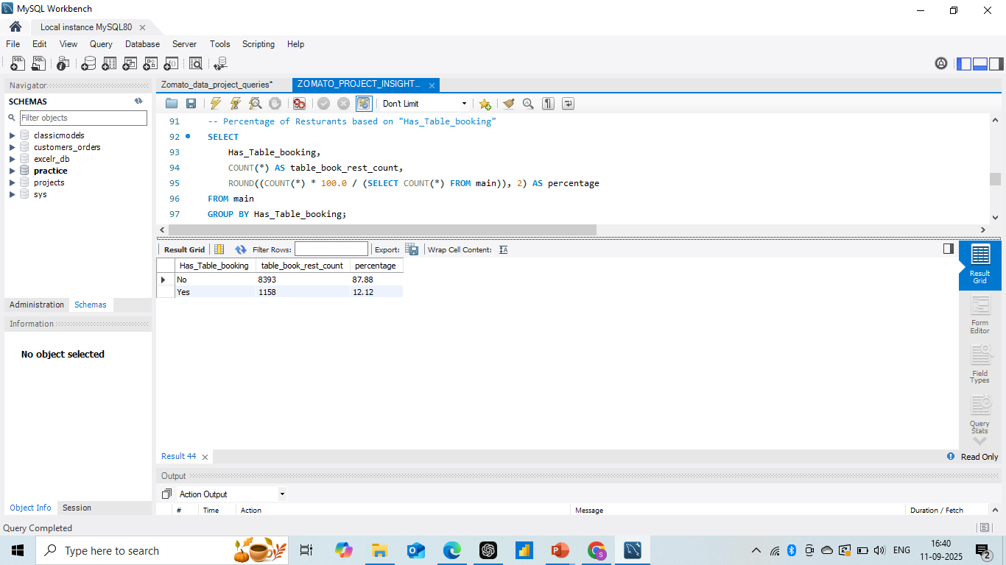

Table Booking
Online Delivery

Slide 14


Zomato
Few more insights :
Insights based on Cuisines, City, Ratings
Top cuisine per country
most expensive city per country
Top & Bottom 5 cities by avg rating.
BY : SABA ATTAR

Slide 15
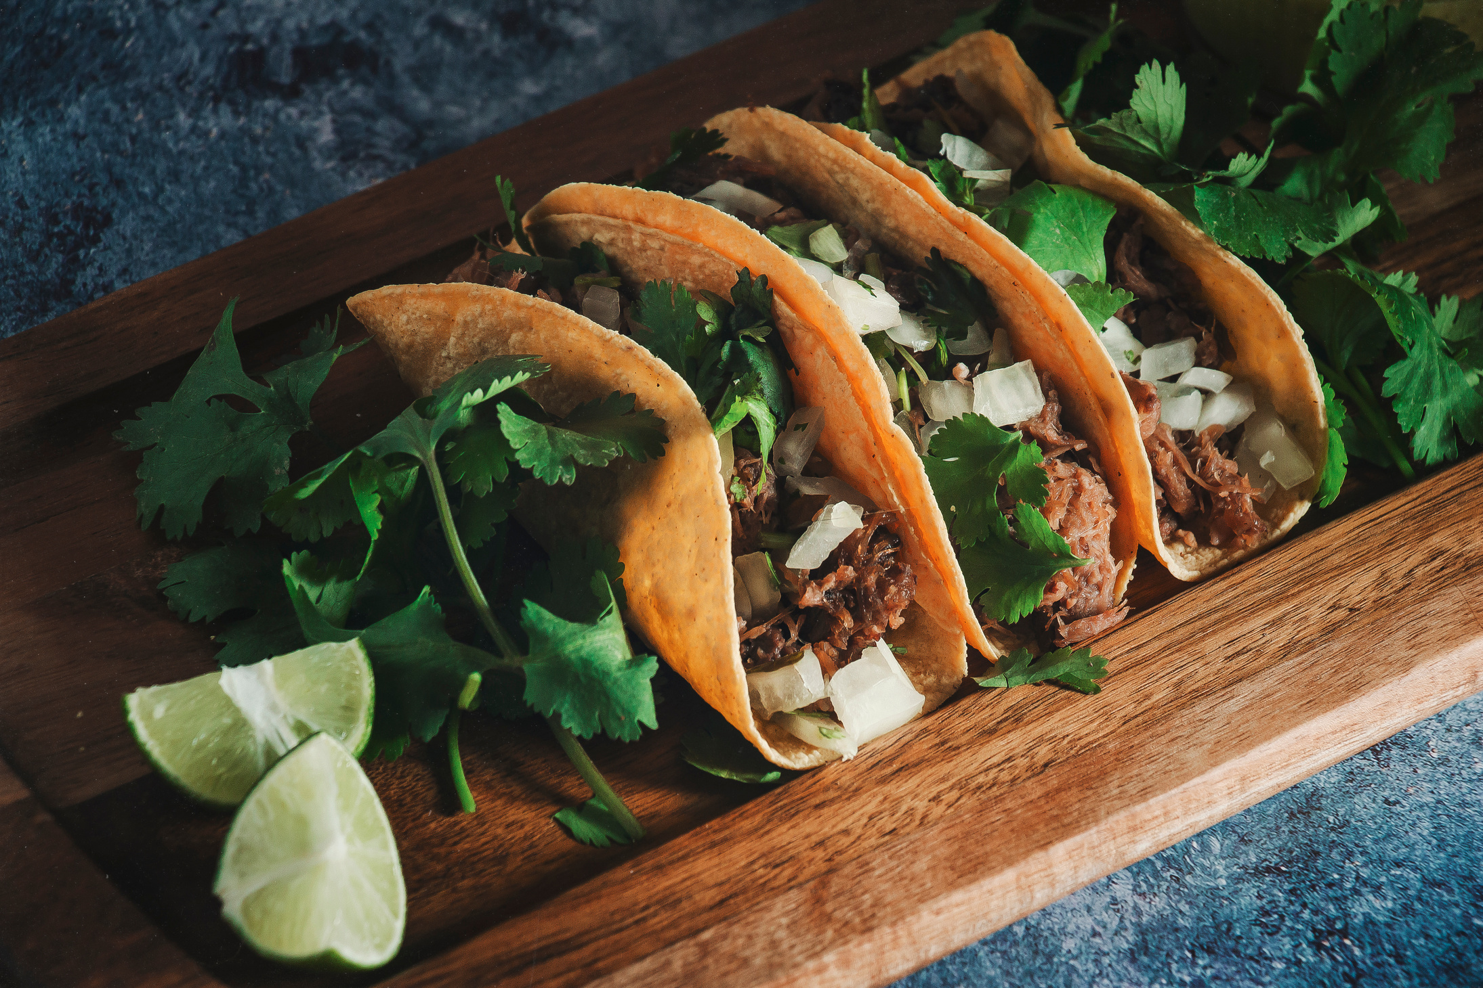

Comparative Insights
Now, let’s look at the comparative insights across the tools we used
Excel was very useful for quick pivot tables and summaries, helping us understand the base statistics.
MySQL helped in cleaning and querying the raw data efficiently, making it easier to generate accurate insights.
Power BI gave us interactive dashboards and KPIs, which helped in trend analysis and understanding customer preferences in detail.
Tableau was best for storytelling and geographic insights, making our analysis visually engaging and easy to interpret.
By combining all four tools, we were able to get a complete 360-degree view of the Zomato dataset—covering raw data, summaries, interactivity, and visual storytelling.
BY : HARSHALI NIKAM

Slide 16


Conclusion & Learnings
here are the key findings from our analysis:
Indian cuisines dominate across global Zomato listings.
Cities like Dubai and Jakarta stand out as premium dining hubs, while New Delhi has the highest number of restaurants.
Most restaurants fall under the medium-cost range, with ratings averaging around 2.9.
Online delivery is very widely adopted at 74%, while only 12% of restaurants provide table booking.
Our learnings include not just insights into food and restaurant trends but also practical skills—working with SQL, Excel, Power BI, and Tableau together.
This project really showed us the importance of using multiple tools to get deeper and more accurate business insights.

Slide 17



